Slide 1
Autoencoder and GAN
Presented : Usman Ahmad

Slide 2
Overview
Autoencoder
Architecture of Autoencoder
Type of Autoencoder
Genearative Adverserial Network (GAN)
How GAN Works
Type of GAN

Slide 3

Autoencoder
An autoencoder is a type of neural network used in unsupervised learning.
It aims to learn efficient representations of input data.
The model compresses the input into a lower-dimensional encoded form.
It then reconstructs the original input from this encoding.
The network is trained to make the output closely match the input.
Common applications include dimensionality reduction, denoising, and feature extraction.
The diagram illustrates an encoder-decoder model where the input "2" is processed by the encoder to create a compressed representation. The decoder then reconstructs the original input "2" from this compressed form, demonstrating the model's ability to encode and decode data efficiently. This process highlights the core functionality of autoencoders in reducing and reconstructing information.

Slide 4
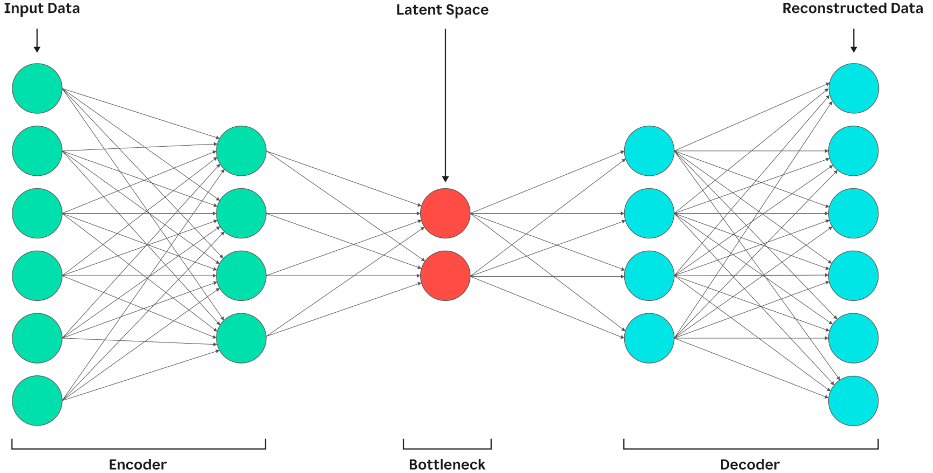
Architecture of Autoencoder
Encoder
Compresses the input into a smaller representation.
Uses layers to reduce the size of the input.
Captures the most important features in the data.
Latent Space (Bottleneck)
Stores the compressed form of the input.
Holds key information needed for decoding.
Called bottleneck due to its narrow size.
Decoder
Reconstructs the input from the compressed code.
Uses layers to expand the encoded data.
Tries to match the output with the original input.
This diagram illustrates the architecture of an autoencoder, consisting of an encoder, bottleneck (latent space), and decoder. The encoder compresses the input data into a low-dimensional latent representation. The decoder then reconstructs the original data from this compressed form as accurately as possible.

Slide 5
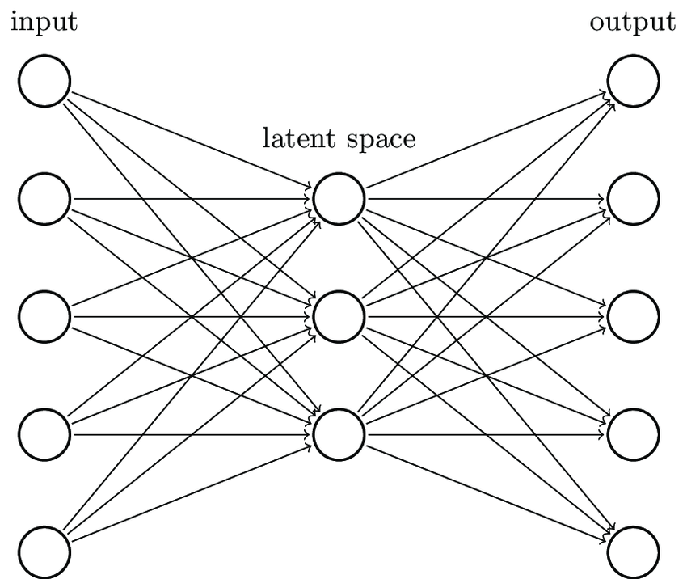
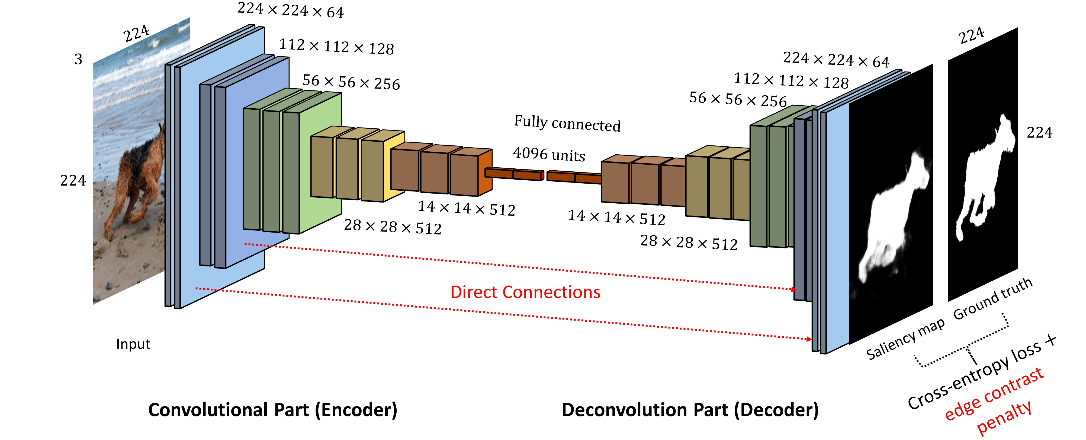
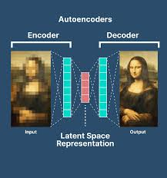
Type of Autoencoder
Vanilla Autoencoder
A vanilla autoencoder consists of an input, a latent space (compressed representation), and an output(reconstructed input). The encoder maps data to the latent space, while the decoder reconstructs it, minimizing reconstruction error. This unsupervised model learns efficient data encodings.
Convolutional Autoencoder
This model uses a convolutional encoder (downsampling) and deconvolutional decoder (upsampling) with skip connections for detail preservation. A fully connected layer (4096 units) processes high-level features before reconstruction. Training optimizes cross-entropy loss + edge contrast penalty for sharp, accurate outputs.
Diagnosing Autoencoders
The encoder compresses input into latent space, while the decoder reconstructs it. Performance is diagnosed by comparing output to input—gaps reveal representation flaws or bottlenecks.

Slide 6
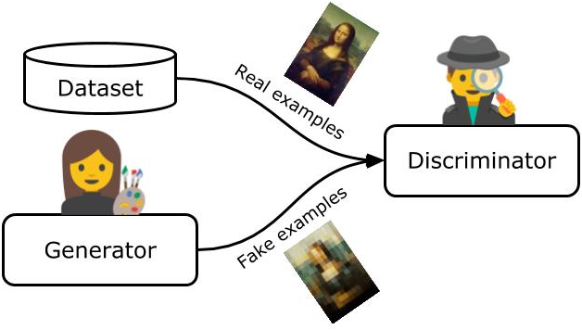
Generative Adversarial Network
GAN is a framework where two neural networks are play together but against each other like a game.
Generator
Takes random noise and tries to generate fake images that look real.
Discriminator
Tries to tell the difference between real images (from the dataset) and fake images (from the Generator).
Adversarial Training
They are trained together but compete the Generator learns to fool, and the Discriminator learns to detect fakes.
This image shows the core components of a Generative Adversarial Network (GAN): the Generator creates fake examples, the Discriminator evaluates them against real data, and both improve through adversarial training, producing realistic synthetic outputs.

Slide 7
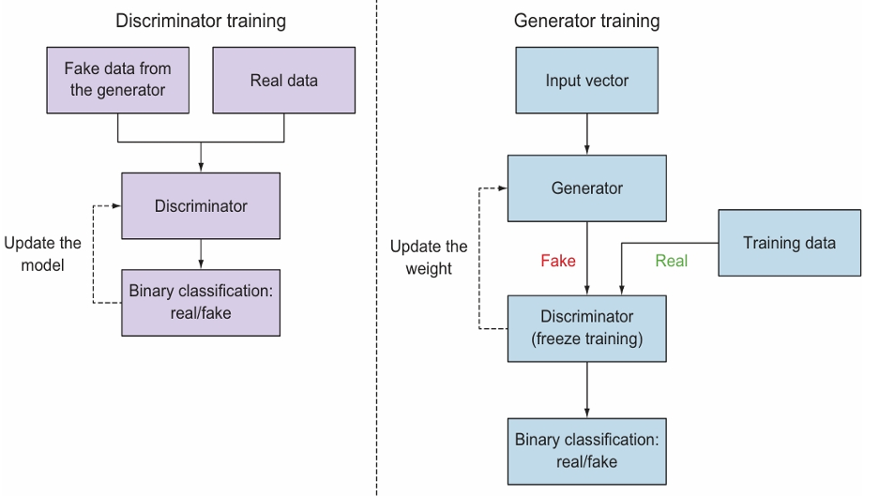
How GAN Works
Train the Discriminator:
The discriminator is a network that tries to distinguish between real data (like actual images from a dataset) and fake data (generated by the generator).
While training the discriminator, you freeze the generator, which means you don't let it learn during this step.
Train the Generator:
You train the generator to create more realistic fake data.
Discriminator doesn't learn, only provides feedback.
This image outlines the training process of a GAN (Generative Adversarial Network), highlighting the alternating steps for the discriminator (classifying real/fake data) and generator (creating fake data). The discriminator is frozen during generator training to focus on improving the generator's output. The goal is binary classification (real vs. fake) for both components.

Slide 8
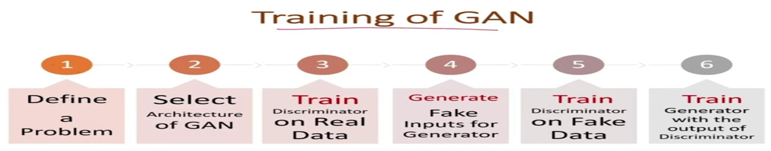
How GAN Works
This image describes the training process of a Generative Adversarial Network (GAN). It begins with defining the problem and selecting the GAN architecture. The discriminator is first trained on real data, then on fake inputs generated by the generator. Finally, the generator is trained using feedback from the discriminator to improve its ability to produce realistic outputs. This adversarial process continues until the generator creates high-quality fake data.

Slide 9
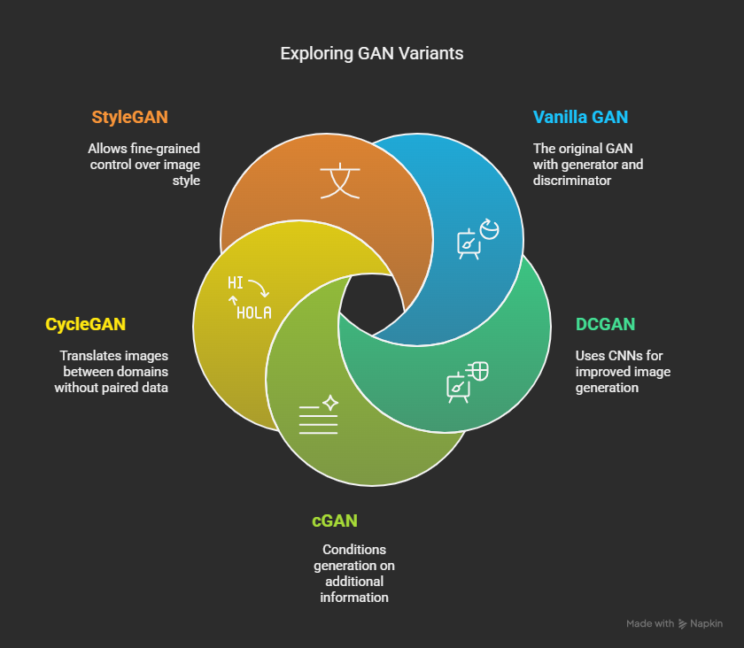
Type of GAN
The image compares five key GAN architectures: StyleGAN offers precise style control for high-quality images, CycleGAN enables unpaired image translation between domains, Vanilla GAN is the original adversarial framework, DCGAN improves stability with CNNs, and CGAN generates conditioned outputs. Each serves distinct generative modeling purposes.

Slide 10
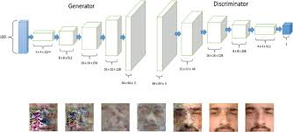
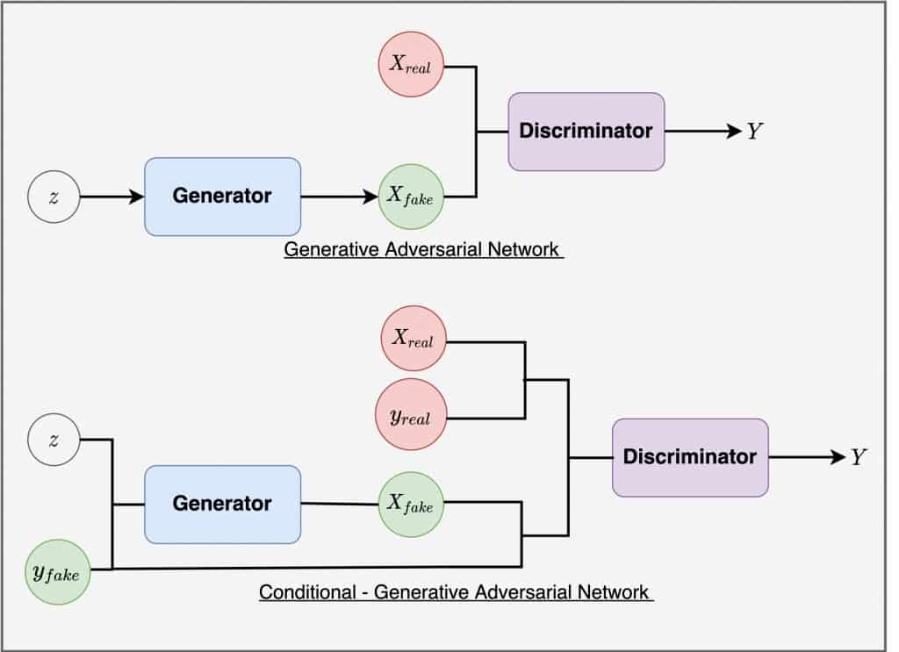
Type of GAN
CNN-based GAN using strided convolutions, batch norm, and LeakyReLU for stable, high-res image generation
Deep Convolutional GAN:
Replaces fully connected layers with convolutional layers for better image generation.
DCGANs are more efficient for generating high-quality images compared to Vanilla GANs.
Conditional GAN(CGAN):
Discriminator: Classifies real/fake data with conditions.
Generator: Produces data matching the condition to fool the discriminator.
Generator creates labeled fake data (Xfake), discriminator evaluates using labels (Y), outputs prediction (yfake).

Slide 11
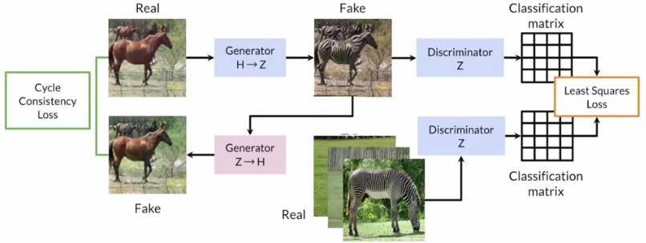
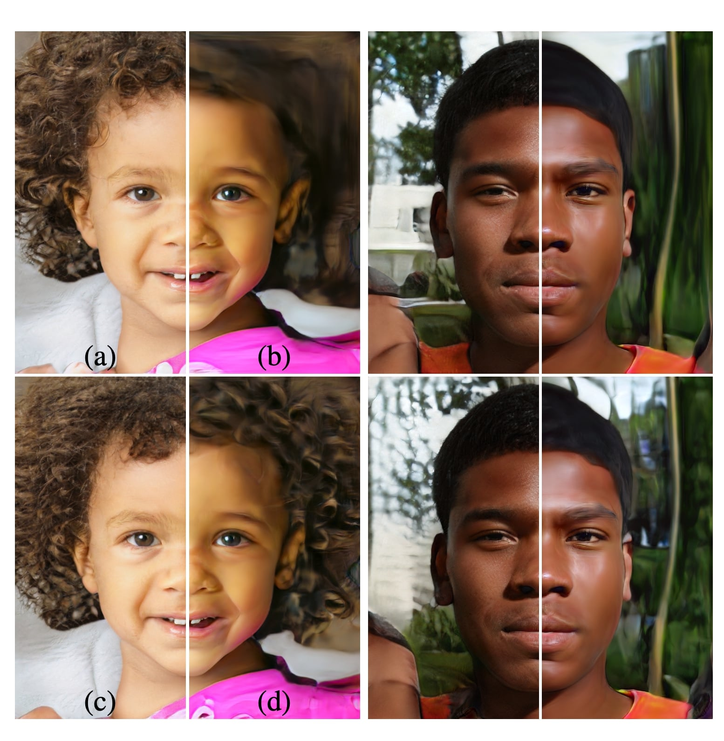
Type of GAN
The diagram shows a cycle-consistent GAN with bidirectional generators (H↔Z), discriminators, cycle loss, and least squares loss for domain translation.
Cycle GAN:
Designed for unpaired image-to-image translation, where the model learns to translate between two domains without requiring paired examples
It has 2 generators and 2 discriminators.
Style GAN:
StyleGAN is a special kind of Generative Adversarial Network (GAN) that creates very high-quality fake images
Introduces a style-based generator architecture, where the input latent vector controls the style of the output image at different levels of detail
This image shows a comparison of real faces (left side) and AI-generated faces (right side) using StyleGAN; the bottom row shows improved quality over the top row.

Slide 12
Thank You

